Slide 1
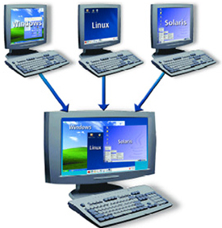
Containers
Docente: Dott. Daniele Gobbo Modulo 1

Slide 2
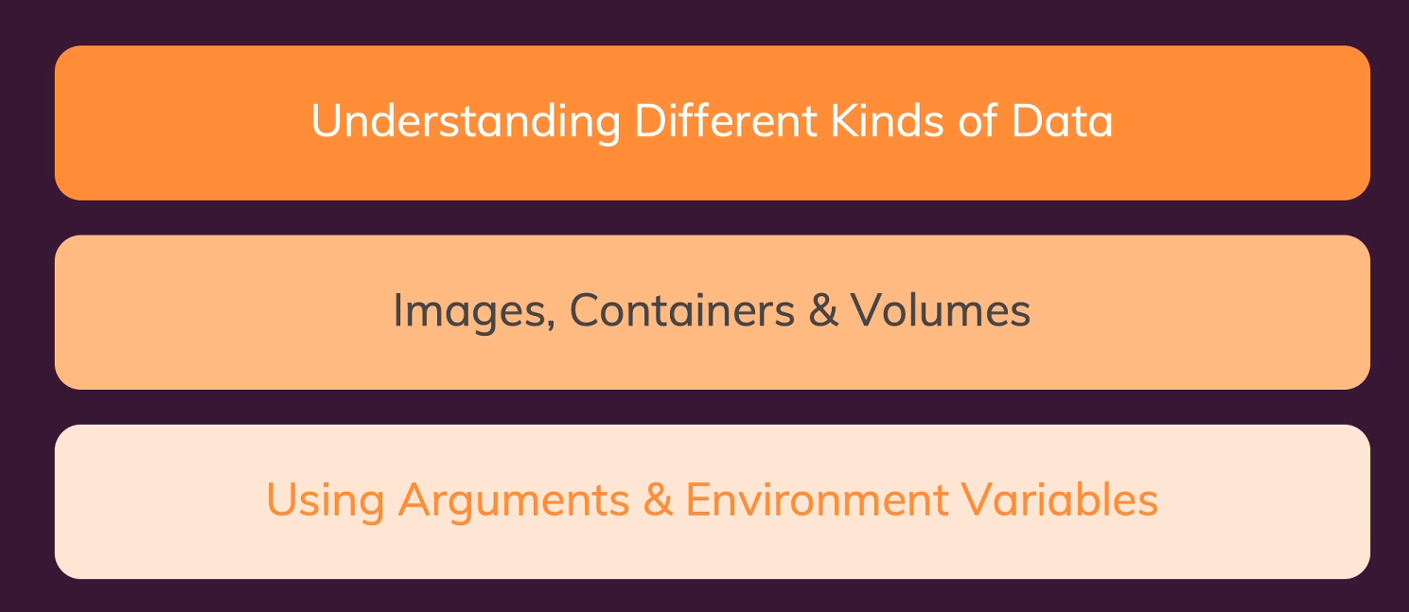
MANAGING DATA AND WORKING WITH VOLUME

Slide 3
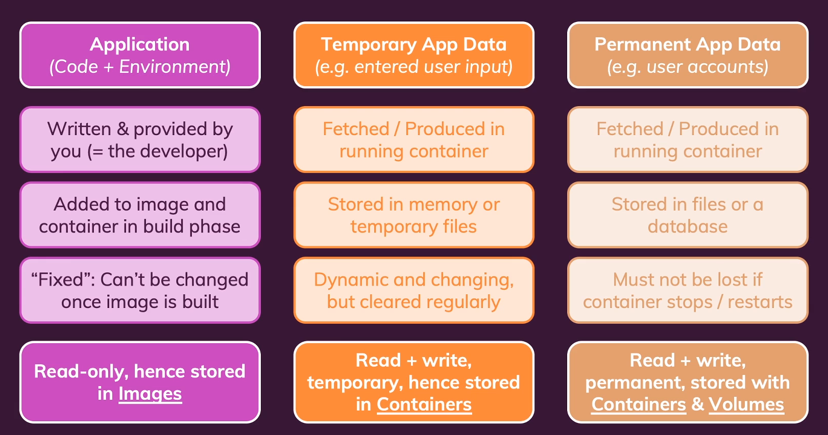
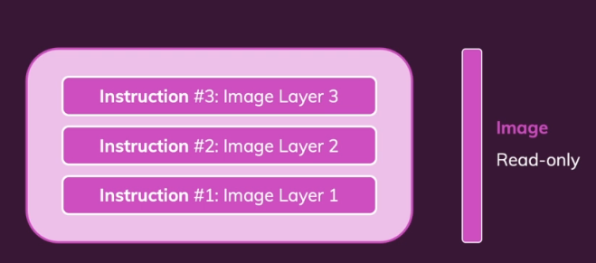
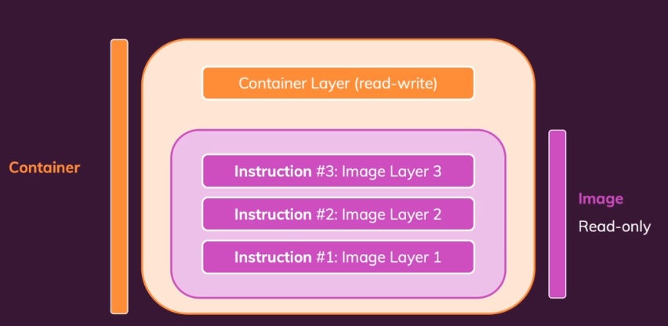
Understanding data categories/different kind of data
For example, if we're talking about a website,
a user might be entering something in a form,
and when we then fetch that data and handle it on the server, which might be running into container, then this entered user data, is temporary data.
We might store it in variables, in our code,
and therefore it's in the end, only stored in memory, or maybe we even store it in a database or in a file.
Losing that data when the containers shuts down
since it's read-write, it's stored in containers
and not in images because images are read-only
When I say stored in the container, the container stores this information, stores files, whatever it is, in this read-write layer, or with help of that read-write layer. But it's all inside of the container. It's not on our local file system, on our local machine, and it's not in the image.
It's in the container
It's permanent application data.
For example, if we got an application, where users can sign up and lock themselves in,
then, we got these user accounts, which we wanna store in files or typically in a database.
And of course that data needs to persist
WE NEED VOLUMES…….

Slide 4
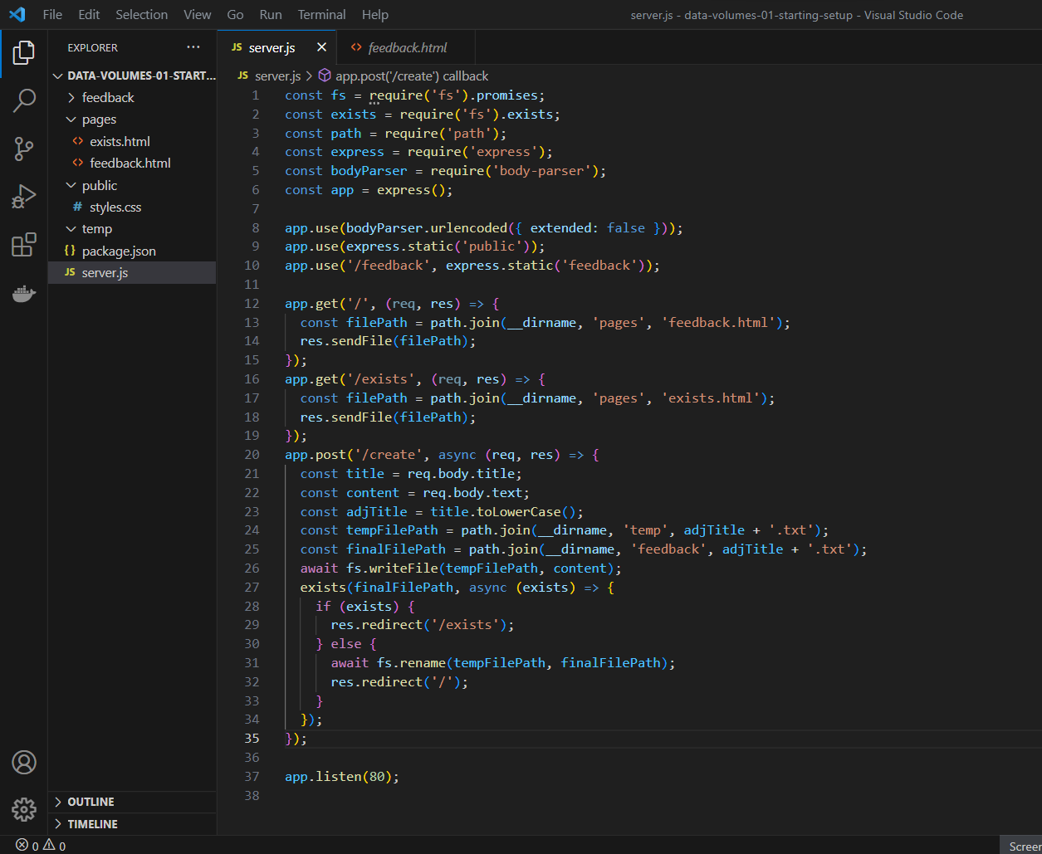
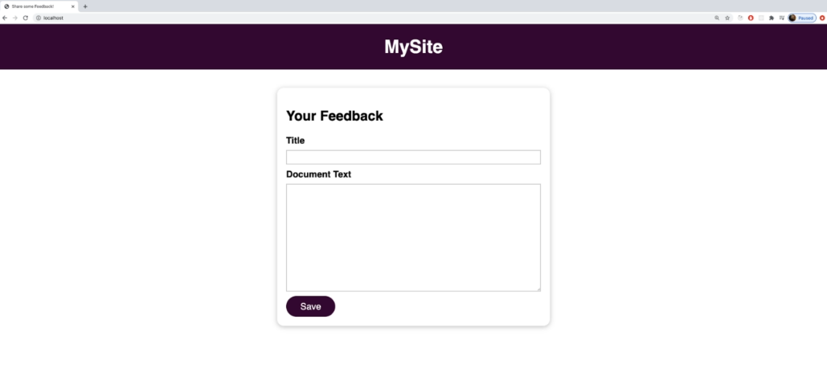
ANALYZE A REAL APP
To demonstrate what I was talking about and to show you these different kinds of data and action, I prepared another project for you,
which we're going to dockerize
PLEASE open in visual studio code “data-volumes-01-starting-setup” folder
in this app we can't see all three kinds of data
in action
in this app we can't see all three kinds of data
in action
Source code
Temp Data
Permanent Data

Slide 5
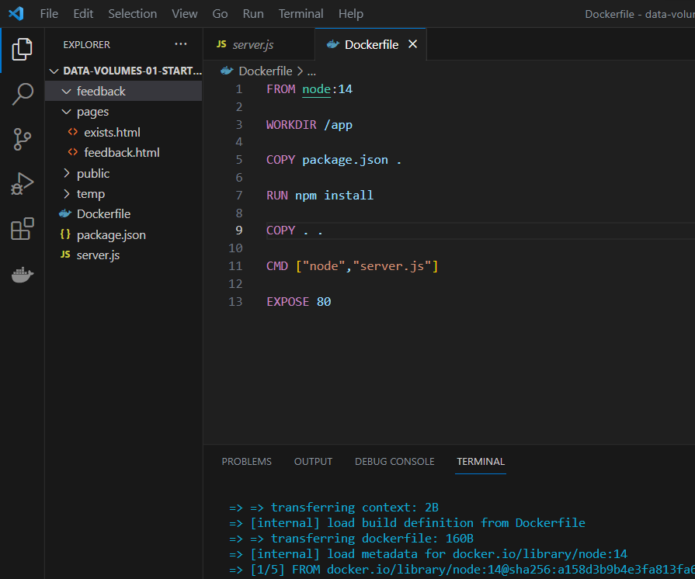
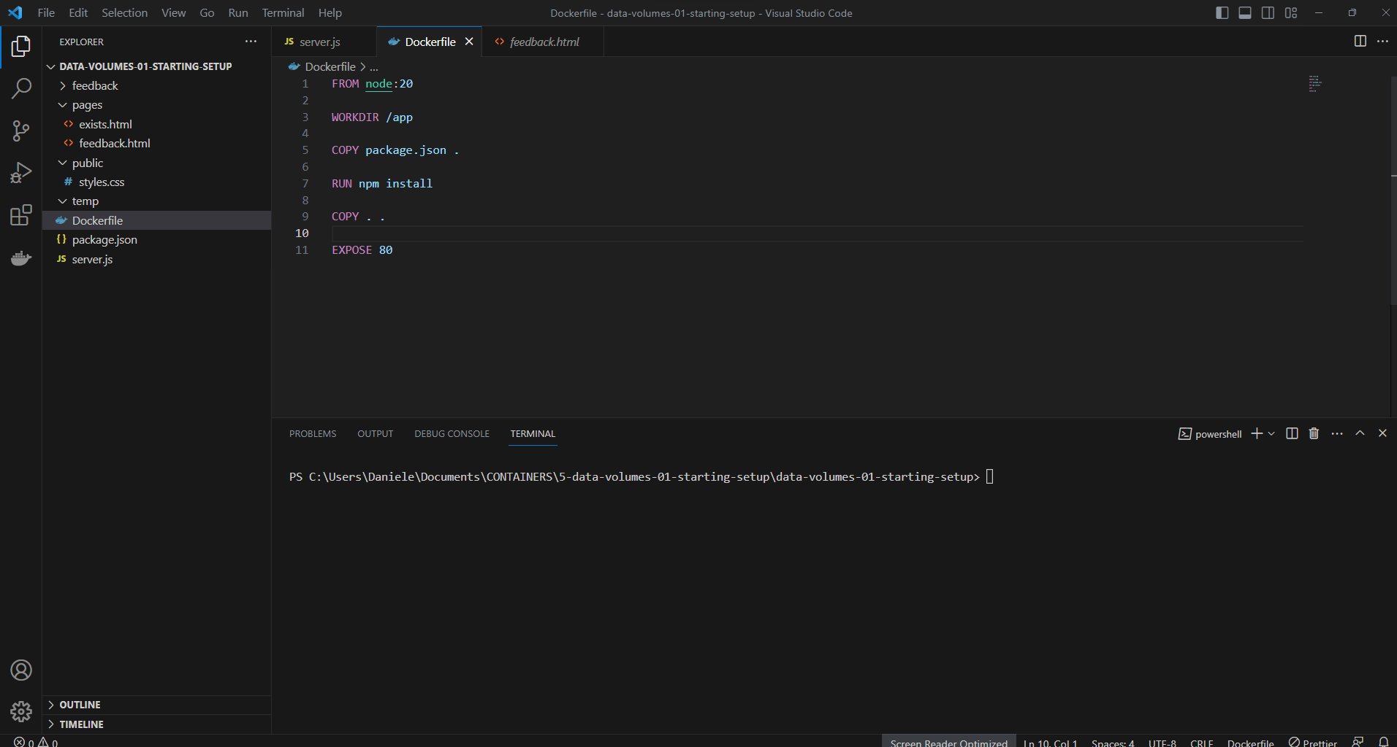
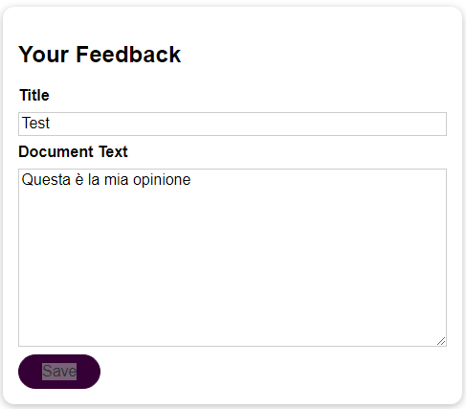
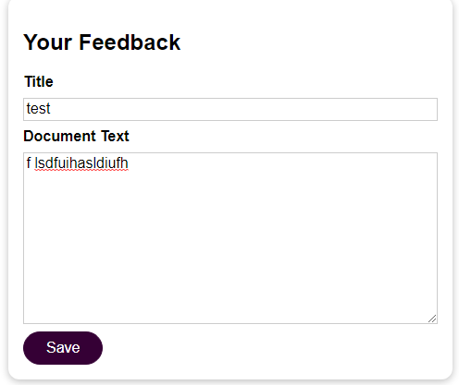
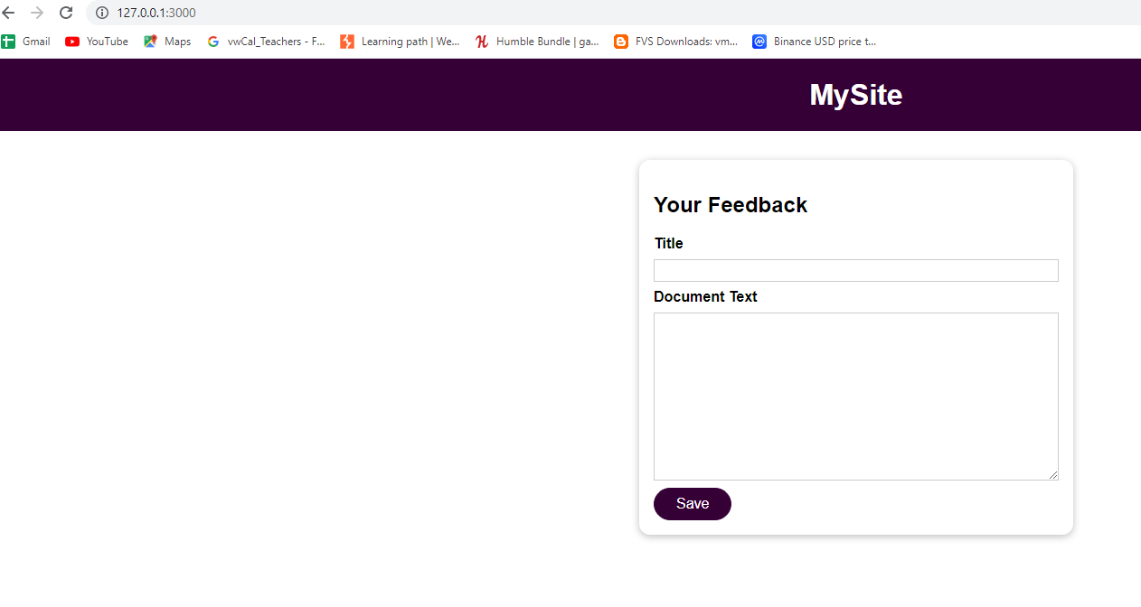
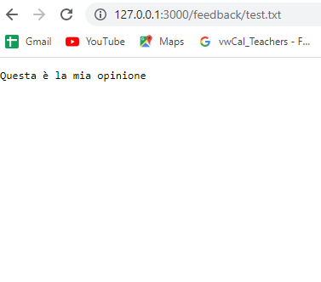
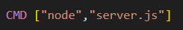
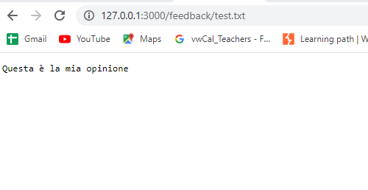
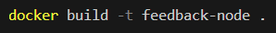
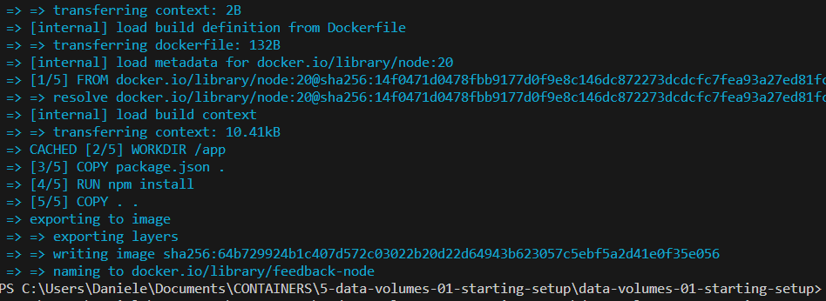

BUILDING & UNDERSTANDING THE DEMO APP
If you look into the feedback folder on your local machine, you will not see this file there.
It only exists inside of the Docker container
which is why we can view it there, but not here.
And the reason for that is that, in the Dockerfile, we copy our local folder into the image and the container is then based on that image.
But that means that the image and therefore also the container has its own file system, based on our local folder here
It is important to always keep this in mind,
there is no connection between your container
or your image and your local file system.
You just initialized his image once,
you can copy in a snapshot of your local folders and files, but there after, that's it.
There is no connection, and that's why we don't see the text file in the feedback folder here on our hosting machine.
It’s time to create a container…..

Slide 6
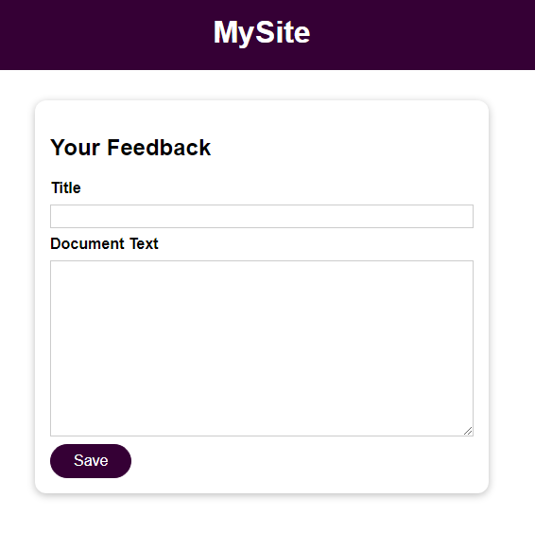
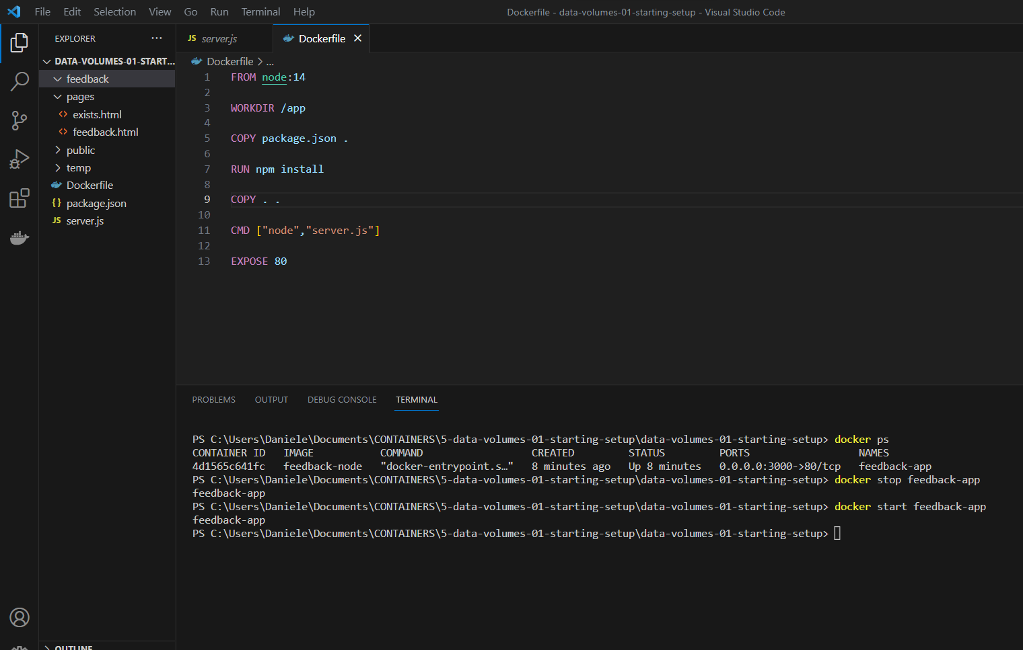
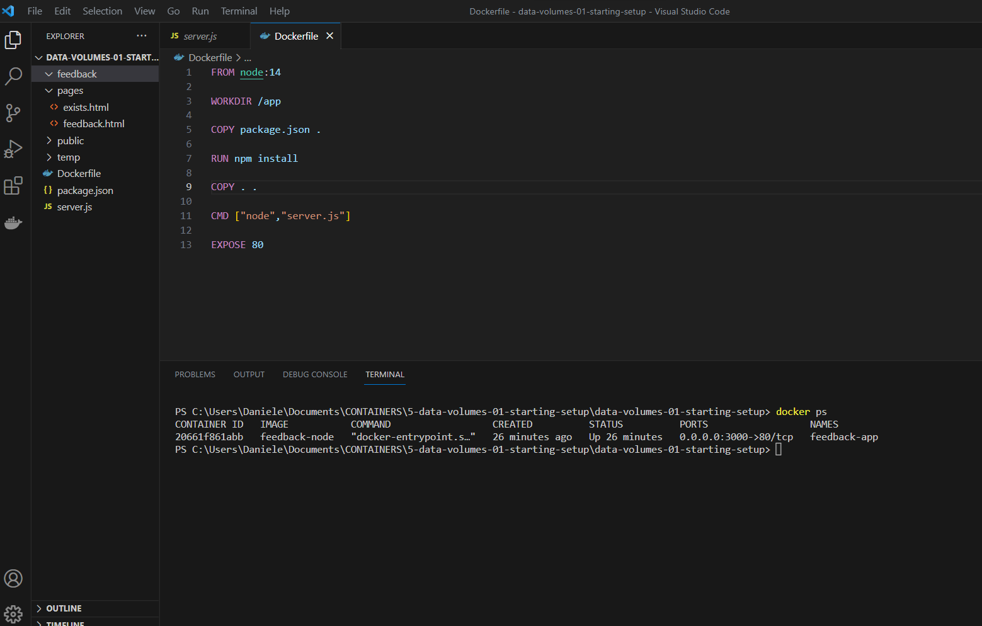
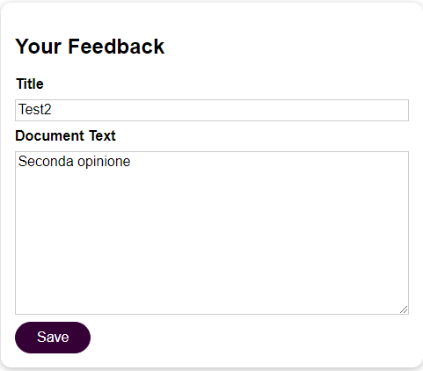
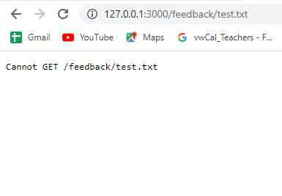
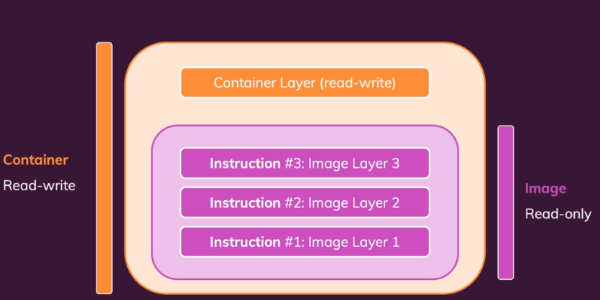
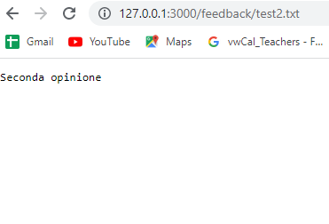
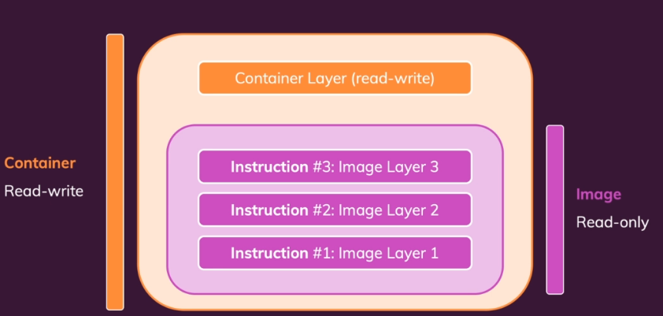
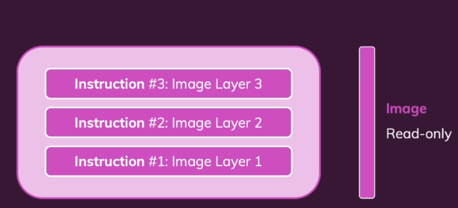
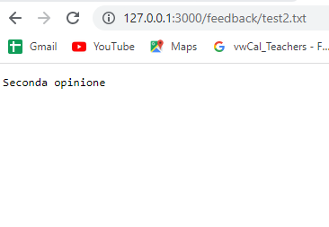
UNDERSTANDING THE PROBLEM
But if we remove a container, then that's different.
Then all the data in the container is cleared
because the container overall is cleared and deleted.
And if we then run a new container, even if it's spaced on the same image, all the data that was created and stored in the previous container is lost, because the image is read-only.
So the container, when a file is generated in the container does not write this file into the image.
It writes it in its own read-write layer
which is added on top
So that's our application running with Docker now and it works.
Everything is great.
Well, here's what's not so great.
First of all, let's stop this application which you of course can do.
Let's stop this container.
And since I added dash --rm when I created the container it is also automatically removed when it's stopped.
Once it's stopped, let's restart it. (without –rm)
that's the case because we deleted the container when we stopped it the first time
And in many applications, this behavior is a problem because here, for example,
we wanna keep those feedback text files around even if a container is deleted.
So now that we know the problem really well
and that we know that containers are able to write data but that this data is lost when the container is removed
Now that we know all of that,
What is the solution?

Slide 7
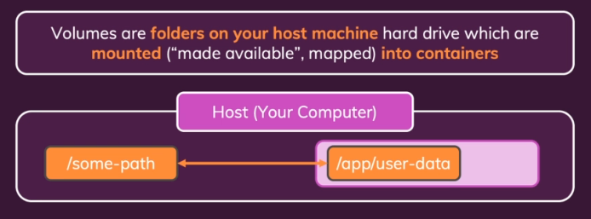
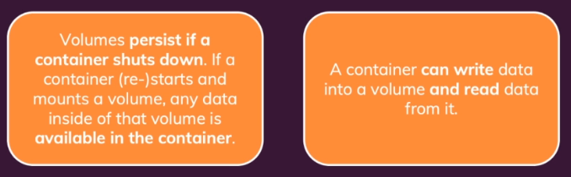
INTRODUCING VOLUMES
Docker has a built in feature called volumes.
And volumes help us with persisting data,
and solving the previous problem.
How do we utilize volumes in our application?
You can really connect a folder, inside of the container, to a folder outside of the container, on your host machine.
And changes in either folder, will be reflected in the other one

Slide 8
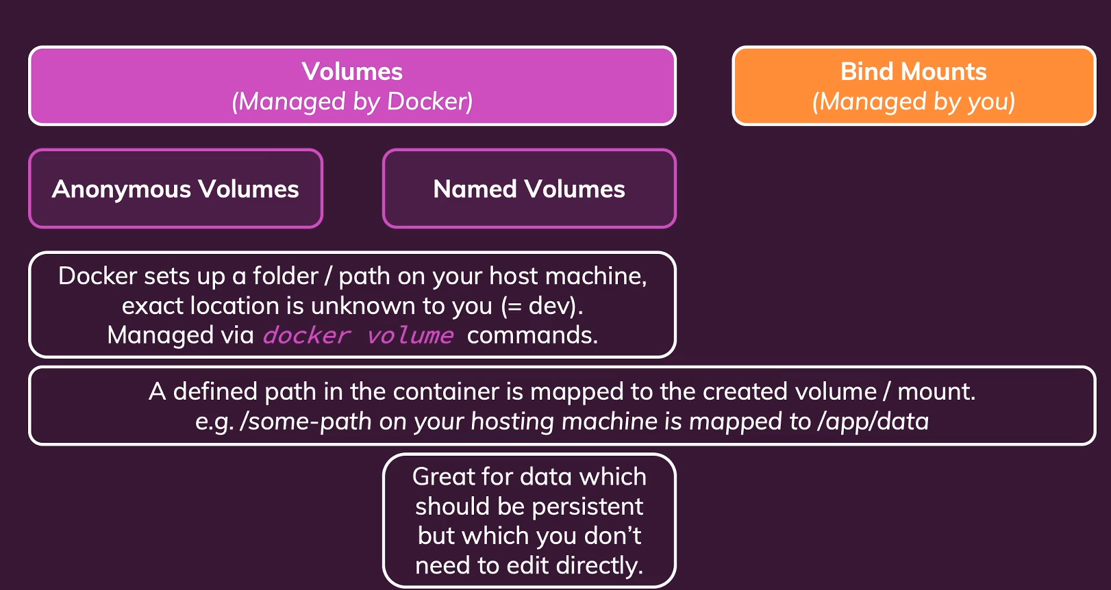
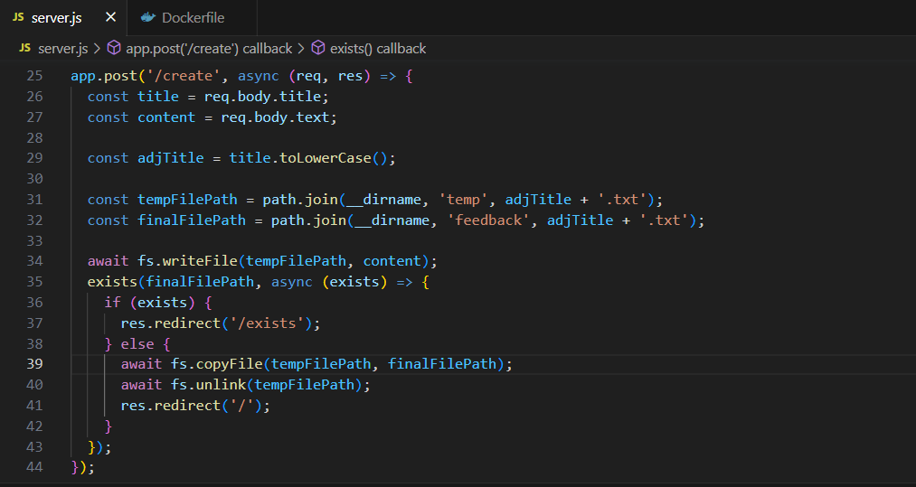
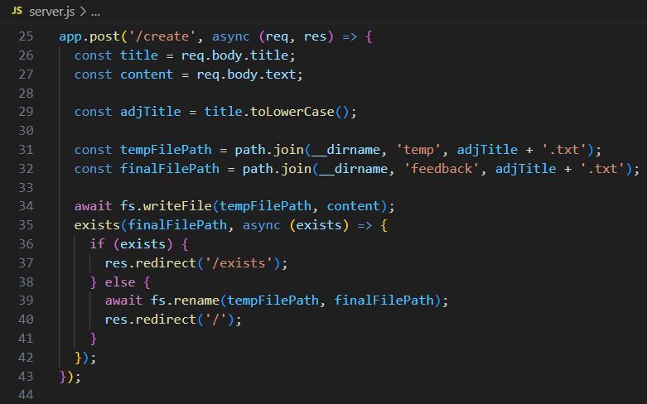
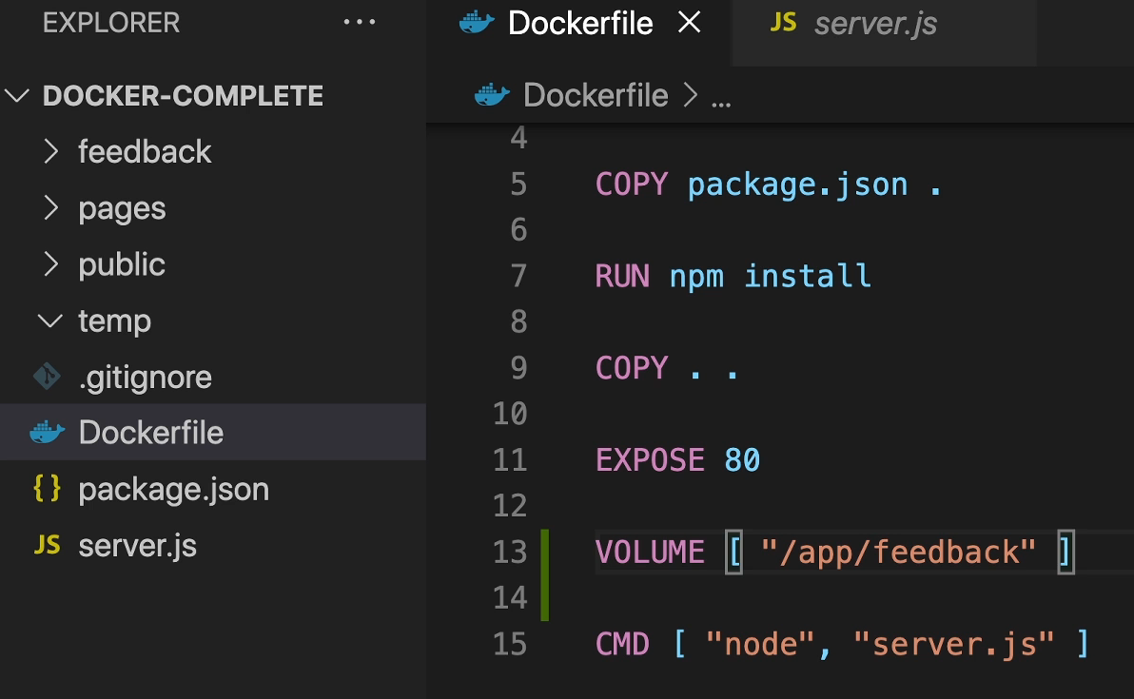
ANONYMOUS and NAMED VOLUME
But with anonymous Volume, when we remove a container that use this Volume, also the volume will be remove…..
For this reason we need proceed with NAMED VOLUME
We have another problem….in our server .js code we have use the RENAME method. This method doesen’t work outside the container. We need change this instruction with these instructions….

Slide 9
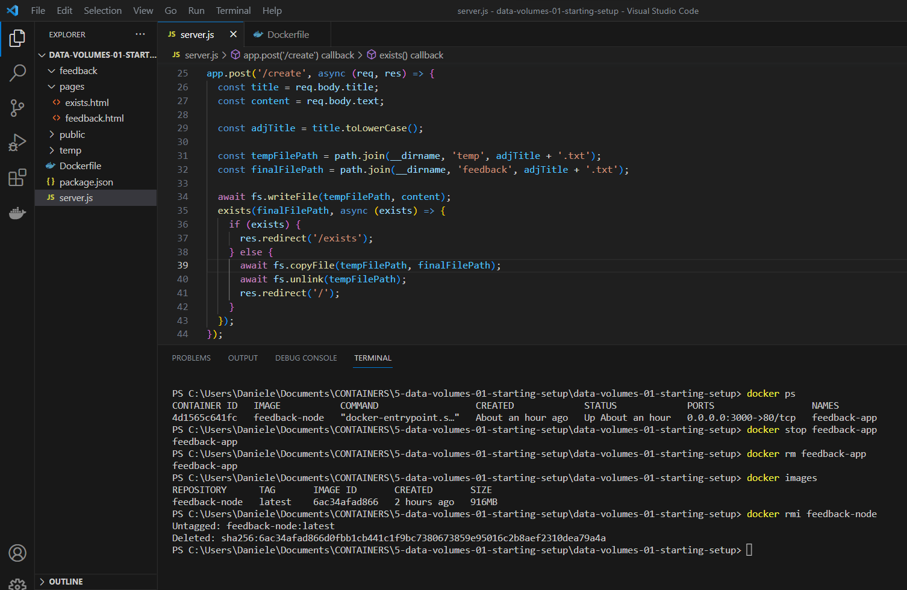
NAMED VOLUME
And the key difference to anonymous volumes
is that named volumes will not be deleted
by Docker when we remove the container

Slide 10
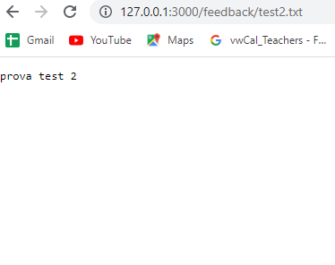
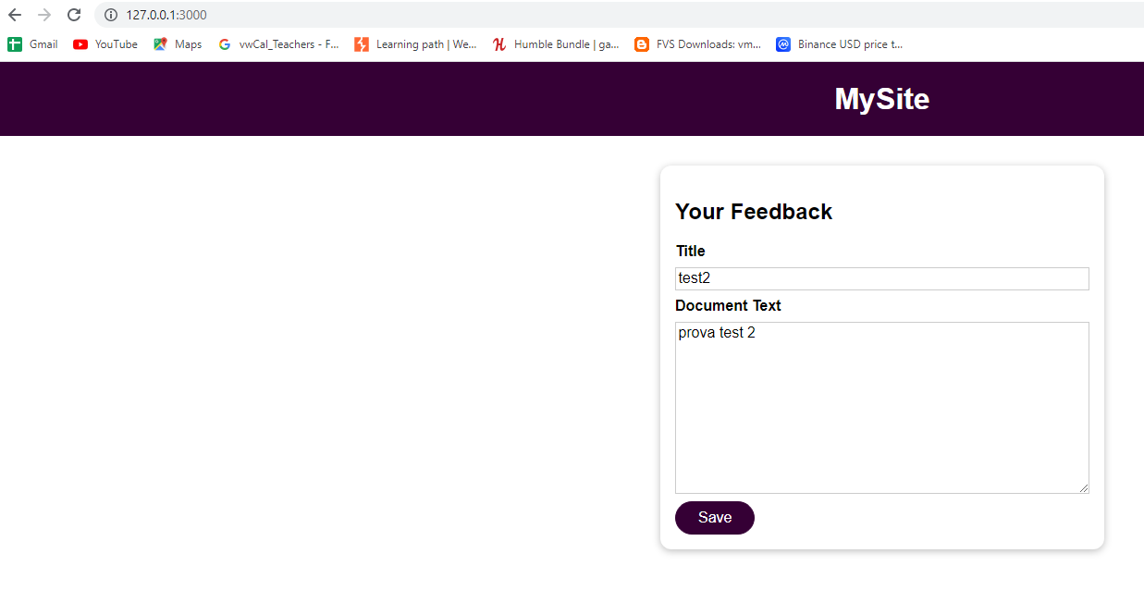
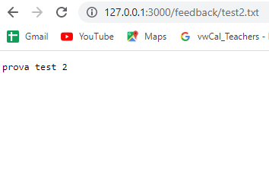
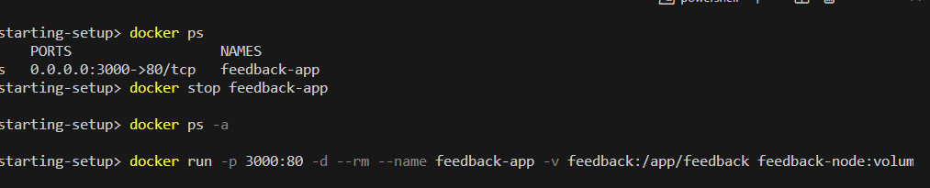
NAMED VOLUME
Data is still here……

Slide 11
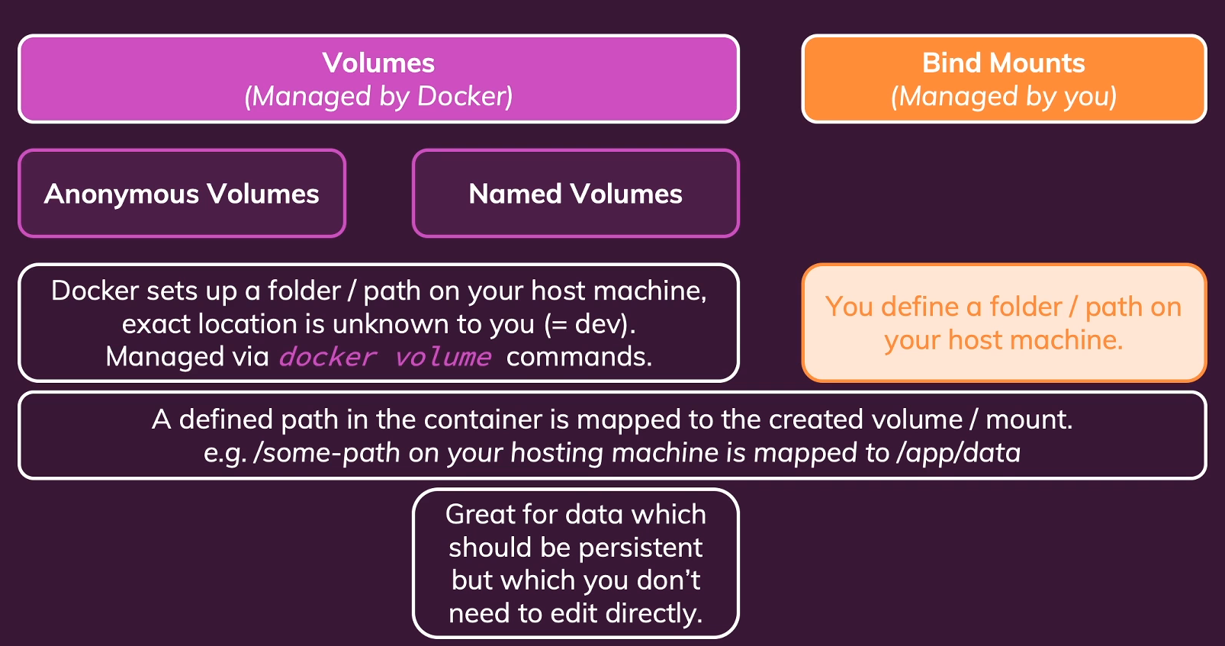
GETTING START WITH BIND MOUNTS (Code Sharing)
Bind mounts, can help us with a different kind of problem.
Whenever we change anything in our source code be that in the server JS file, or in any HTML file , those changes are not reflected in the running container unless we rebuild the image
But, during development, if we're using Docker, it would be pretty important to us,
that such changes are reflected. Because otherwise, we always have to rebuild the entire image and restart a container, whenever we change anything
Bind mounts have some similarities with volumes, but there is one key difference.
Where volumes are managed by Docker,and we don't really know where on our host machine file system they are.
For bind mounts, we do know it.
Because for bind mounts, we, as a developer, set the path to which the container internal path should be mapped on our host machine
So here, we're fully aware off the path on our localhost machine.
And since that is the case, and containers cannot just write to volumes, but also read from there, of course we could put our source code into such a bind mount.
And if we do that, we could then make sure that the container is aware of that, and that the source code is actually not used
from that copied in snapshot, but instead from that bind mount.
So bind mounts are therefore perfect, for persistent and editable data.
And that's the difference to normal volumes.
A named volume can help us with persistent data, but editing is not really possible, since we don't know where it's stored on our host machine.

Slide 12
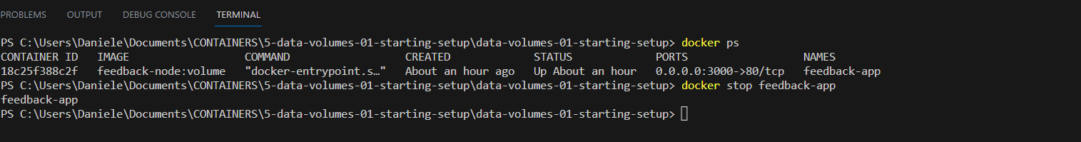
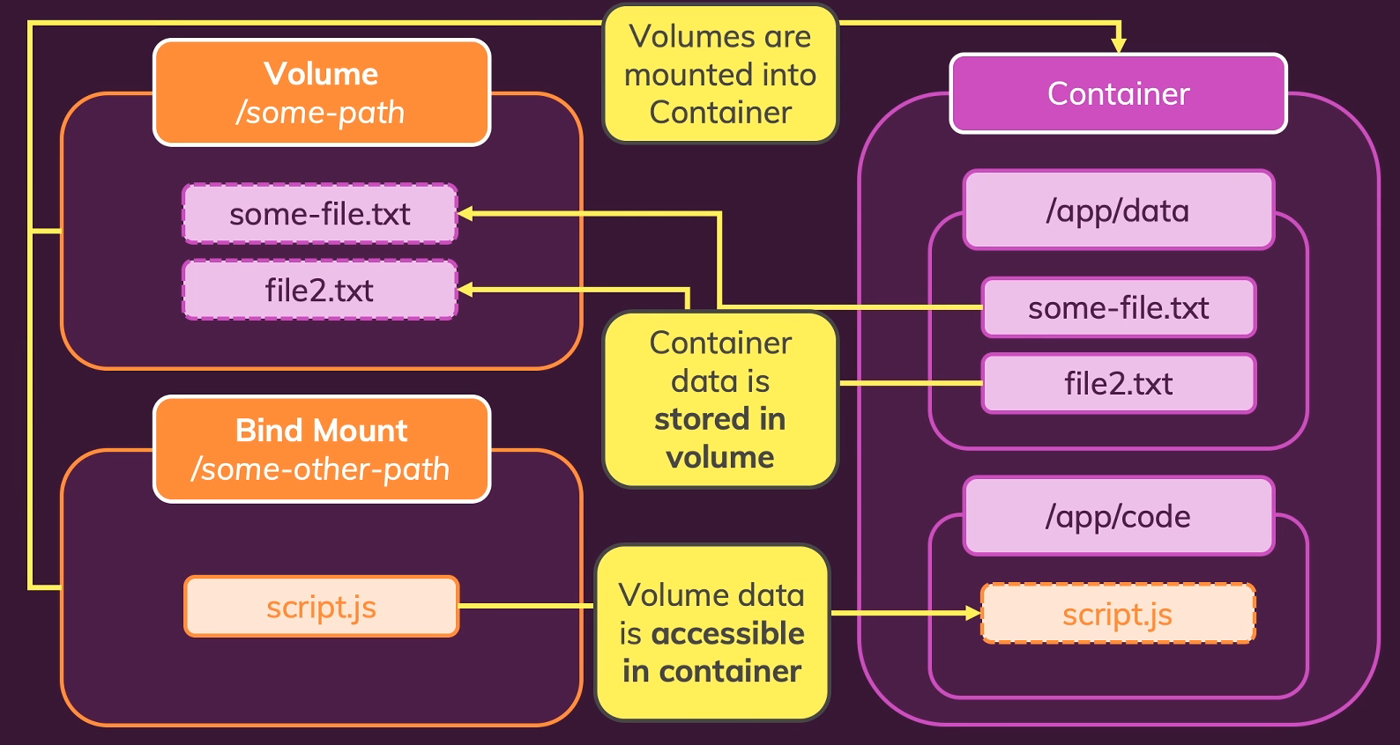
GETTING START WITH BIND MOUNTS (Code Sharing)
we have to set up a bind mount from inside the terminal when we run our container

Slide 13
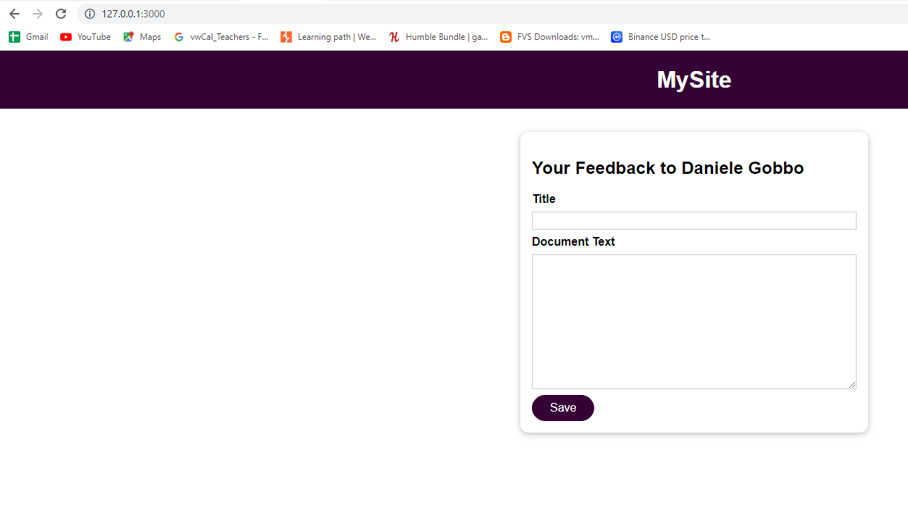
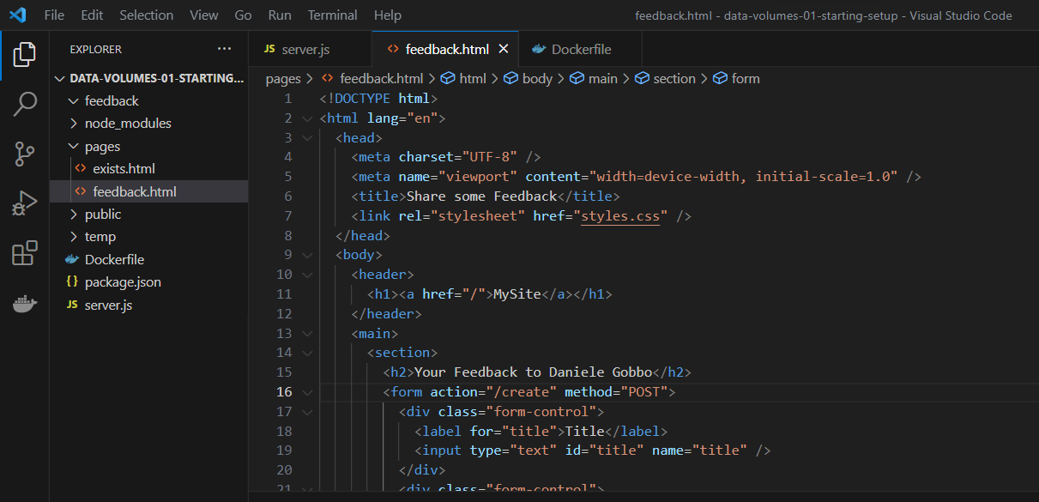
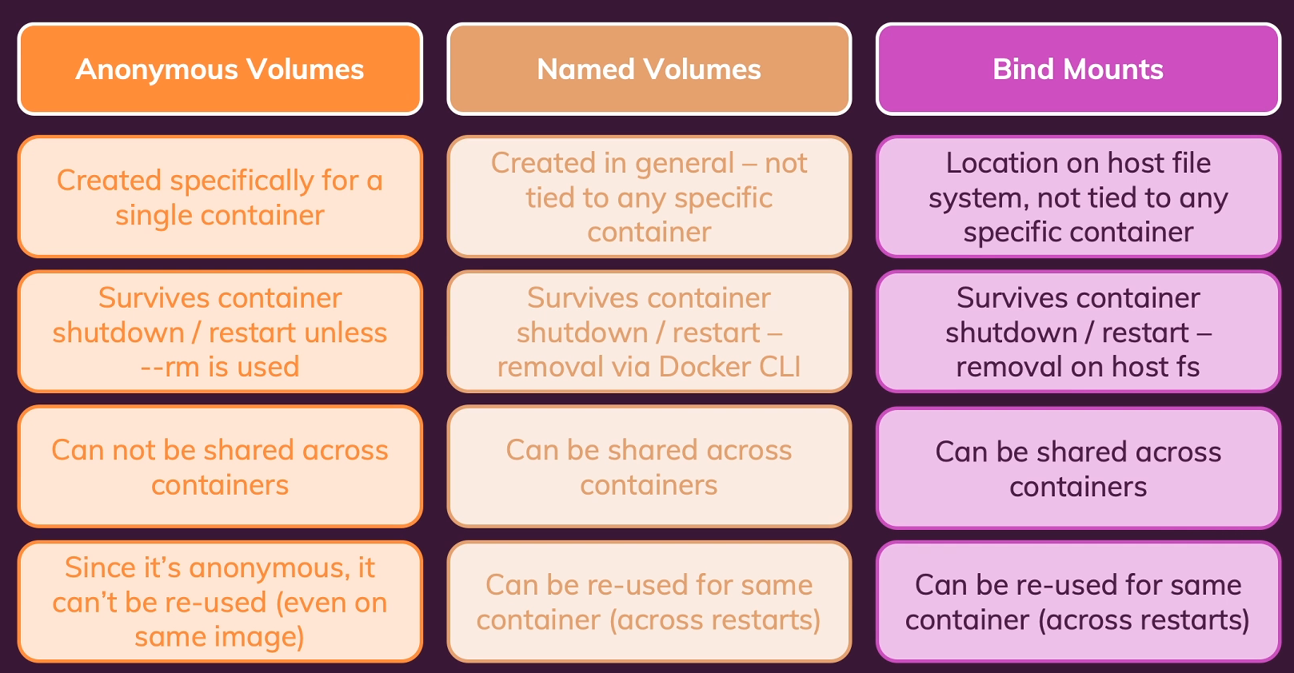
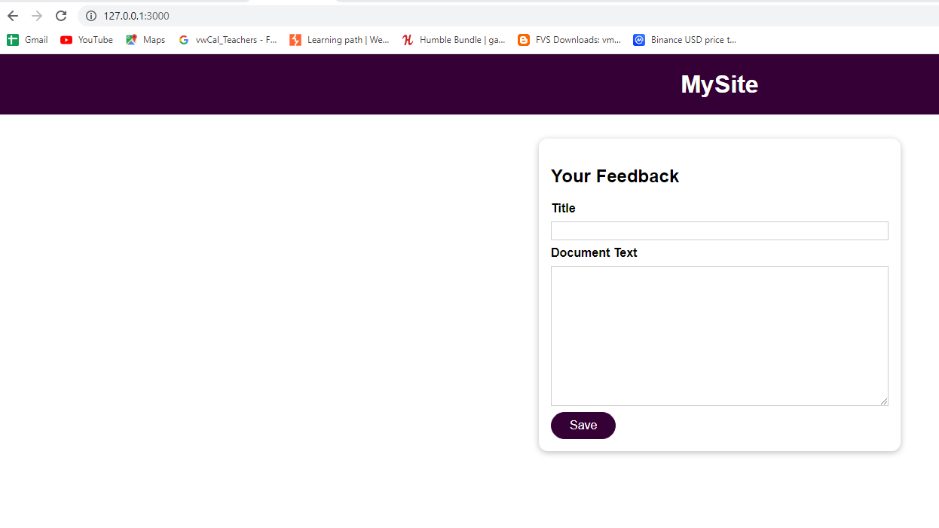
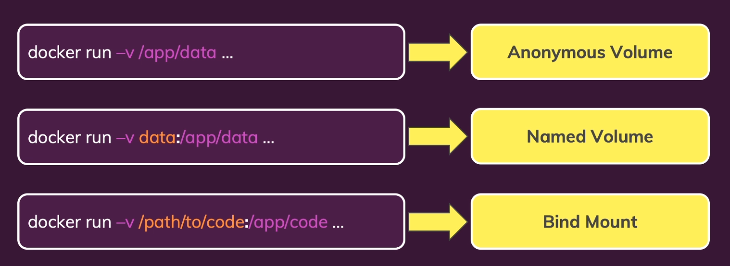
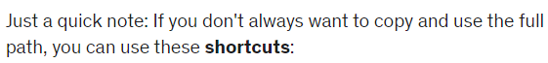
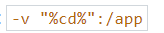
GETTING START WITH BIND MOUNTS (Code Sharing)

Slide 14
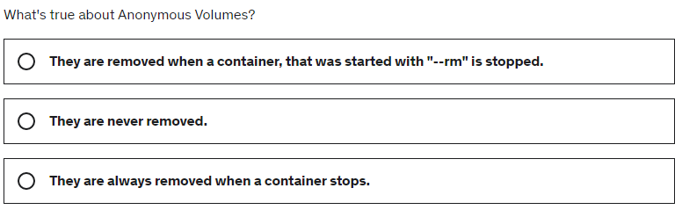
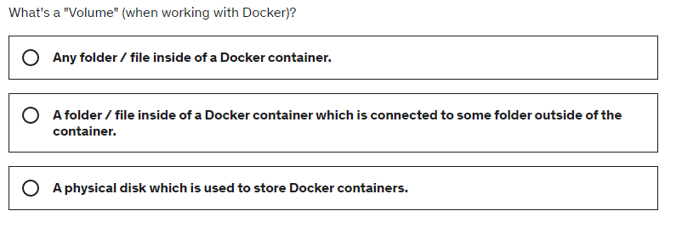





QUIZ TIME

Slide 15
READ-ONLY VOLUMES

Slide 16
READ-ONLY VOLUMES
If we think about this bind mount, the idea is that we can edit our source code here, and changes are automatically available inside of the container.
The idea is definitely not that the container should be able to write into the app folder, the container should not be able to change the files in there, only we should be able to change them on our host machine file system, not from inside the container, the running application in the container should not change these files.
By turning this bind mount
into a read only volume
By default volumes, are read write, which means the container is able to read data from there and write data to them.
But you can restrict that by adding an extra colon after the container internal path, and then RO for read only. This ensures that docker will now not be able to write into this folder or any of its sub-folders.
Feedback folder is a read/write volume. OK
But we have also Temp folder that we want also in a read/write Volume…..
This ensures that docker will now not be able to write into this folder or any of its sub-folders.
Of course, we on our hosting machine still will be able to change these files.
PLEASE START THIS CONTAINER…..

Slide 17



MANAGING DOCKER VOLUMES
When you remove a volume, all the data in it is lost.
And if you then create the same volume again,
so a volume with the same name,
that will not bring back your data.

Slide 18



Don’t COPY Everything: USING «dockerignore» files
Previously, I also copied just package.Json to the working directory
if a node modules folder would exist here,
which it doesn’t, but which would be the case,
if they would run npm install on my host machine, in this project folder, that such a folder is not getting copied into the image.
Because if we would copy it in, we would overwrite the node modules folder which is created inside of the image with npm install.
And that's bad,
because our locally existing node modules folder could be outdated.
At the moment this copy instruction copies everything in the folder where this Docker file lives, because I just have a dot here, which means everything
but we can also restrict what gets copied here.
And we do this by adding a “.dockerignore” file here.
The dot at the beginning is important

Slide 19
















ARGUMENTS & ENVIROMENT VARIABLES
We have two options that we can set in our Docker file and on our docker build and docker run commands
Oggetto
Chiave
This is a default value. We can use this variable on EXPOSE COMMAND
We now need to expose the internal PORT 8,000
because since we set the environment variable to that, this 8,000 PORT will be used here and also in the server JS.
But now we don't need to rebuild the image
just to change the PORT.
Thanks to the environment variable, we can just do it like this in the run command.
And if I start that and reload, it still works, which means that setting this new PORT was successful.
Variabile
Now the advantage of using environment variables is that we now can configure this.
When we run this container though, we're not limited to this hard-coded value (ENV PORT 80).
We just have a default value here, but we don't have to stick to that.
So again, I can stop this container
and then run this again, but now with an extra option
And args and environment variables allow you to create more flexible images and containers because you don't have to hard-code everything into these containers and images.
Instead, you can set it dynamically when you build an image or even only when you run a container
you can also specify a file that contains your environment variable
Often such a file is named .env,
but you don't have to name it like this.
And then in this file, you could set up
your environment variable key value pair…..
that's the default port for HTTP requests,
but during development or for whatever reason, we might want change this
at the moment, this environment variable is not set. We need to set it in the docker file
Arguments allow you to set variables in your Dockerfile which you can use in there to put different values into certain Dockerfile instructions based on arguments that are provided with the --build-arg option when you run docker build.
Environment variables are available inside of a Dockerfile like arg, but args are available in your entire application code in your running applicationand you can set them with the env option inside of a Dockerfile,

Slide 20









USING BUILD ARGUMENTS
One note about where you specify args and envs……
Now that were environment variables, which we set up at runtime with the Docker run command, and they can be very useful as you saw.
Now what are build-time arguments?
With those, we can actually plug in different values into our Dockerfile, or into our image when we build that image without having to hard code these values into the Dockerfile.
Now we can build our image with a name of feedback-node and then a tag it web-app.
And they offer we wanna use port 80.
And hence, we don't have to specify anything,
because that's actually the default for our argument.
So we can just build it like this:
Default value is still hard coded to 80.
That might make sense
and might not be a problem at all.
But maybe we want to make this default value
flexible as well.
So that when we build the image, we can actually build the image based on one and the same unchanged Dockerfile multiple times
with different default values.
We can achieve it
with build-time arguments
This argument cannot be used in your code, it's not available there, you can only use it in your Dockerfile.
And even there, you can't use it on every instruction.
You cannot use it on CMD command, for example, because that's a runtime command in the end, which is executed when the container starts.
But you can use your arg on all the other instructions.
And therefore we can also use it on the ENV instruction, for example, to set the default value for this environment variable.
not place it right at the beginning of your Dockerfile because these instructions just like all other instructions, add layers to your Dockerfile.
And hence, when something changes about them, all subsequent layers are rebuilt, are re-executed.
So all subsequent instructions are re-executed.
And I don't wanna execute npm install again all the time
And now we're again building an image
on a different tag with a different arg value.
There after this value is locked in.
But now we got two images based on the same Dockerfile, where we didn't need to change any code.
And yet, we're using a different port number

